Slide 1

SONG
RECOMMENDER
PRESENTED BY:
B.HARIHARAN
513121104305
THANTHAI PERIYAR GOVERNMENT INSTITUTE OF TECHNOLOGY-VELLORE.

Slide 2
TITLE
SONG RECOMENDER
Based on Mood

Slide 3
Agenda
Problem Statement
overview
Solution and Proposition
Your solution
Result and evaluation
Conclution

Slide 4
Problem statement
With the increasing popularity of music streaming services, users often find themselves overwhelmed with the vast library of songs available.

Slide 5

Overview
In our presentation, we introduce a Mood-Based Song Recommendation System designed to revolutionize music discovery. Leveraging advanced algorithms, our system analyzes song lyrics and user mood to provide personalized song recommendations. With an intuitive user interface, users can effortlessly explore songs tailored to their emotions.

Slide 6

THE END USER
The end users of the Mood-Based Song Recommendation System are individuals who use music streaming platforms or applications to listen to music. These users could include music enthusiasts, casual listeners, or anyone looking to discover new music that matches their mood or emotions.
User

Slide 7
Solution
RECOMMENDATION
Our Mood-Based Song Recommendation System utilizes advanced algorithms to analyze song lyrics and user mood, delivering personalized song recommendations. With an intuitive user interface, users can effortlessly explore curated music tailored to their emotions. Experience the future of music discovery with our innovative solution

Slide 8

WOW IN OUR SOLUTION
Our solution empowers music enthusiasts and casual listeners alike by providing personalized song recommendations tailored to their current mood. With an intuitive interface and advanced algorithms, users can seamlessly explore curated playlists that resonate with their emotions, enhancing their music discovery experience.

Slide 9
Modeling
The model used in the code is a content-based recommendation system. It employs TF-IDF and cosine similarity to analyze song lyrics and recommend songs based on the user's mood. The system matches songs with similar textual features to provide personalized recommendations.

Slide 10
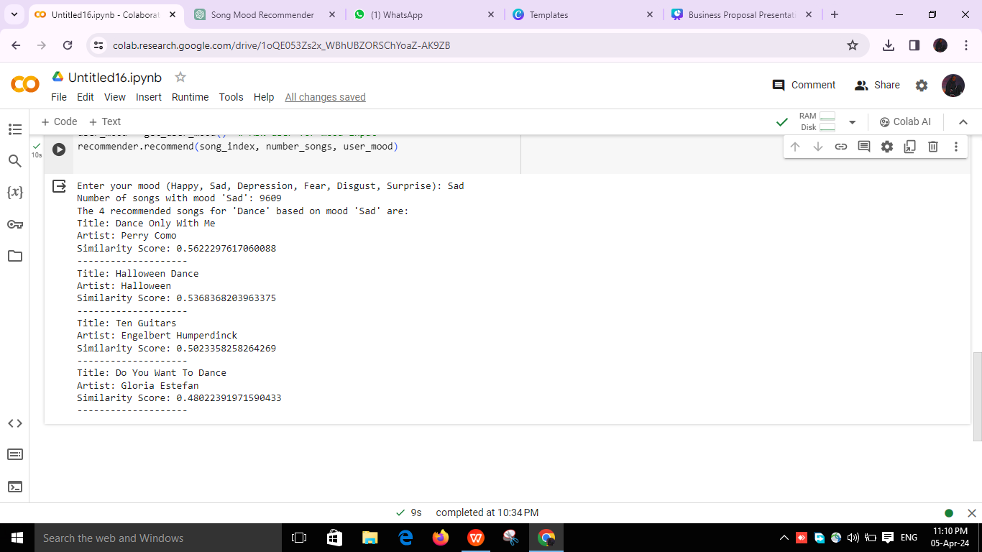
RESULT:

Slide 11
Conclusion
The Mood-Based Song Recommendation System offers personalized song suggestions based on user mood, enhancing music discovery experiences. By leveraging advanced algorithms and intuitive user interfaces, the system aims to revolutionize how users engage with music. This innovative solution holds promise for reshaping the future of music streaming platforms.

